Slide 1
Data Science 101
Day 3: Basic Mathematics

Slide 2

About Me
Join us: https://www.linkedin.com/groups/6707800/
Twitter: https://twitter.com/Sanjeet36284331
Linkedin: https://www.linkedin.com/in/sanjeetshukla/
Sanjeet Shukla
Data Scientist-Big Data
Cognizant Technology Solutions

Slide 3
Poisson's Experiment
A Poisson experiment is a statistical experiment that has the following properties:
The experiment results in outcomes that can be classified as successes or failures.
The average number of successes (μ) that occurs in a specified region is known.
The probability that a success will occur is proportional to the size of the region.
The probability that a success will occur in an extremely small region is virtually zero.
Note that the specified region could take many forms. For instance, it could be a length, an area, a volume, a period of time, etc.

Slide 4
Notation
Following notation is helpful, when we talk about the Poisson distribution.
e: A constant equal to approximately 2.71828. (Actually, e is the base of the natural logarithm system.)
μ: The mean number of successes that occur in a specified region.
x: The actual number of successes that occur in a specified region.
P(x; μ): The Poisson probability that exactly x successes occur in a Poisson experiment, when the mean number of successes is μ.

Slide 5
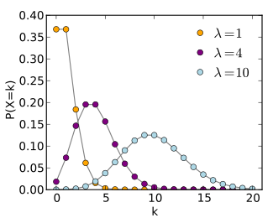
Poisson’s Distribution
A Poisson random variable is the number of successes that result from a Poisson experiment. The probability distribution of a Poisson random variable is called a Poisson distribution.

Slide 6

Poisson Formula
Suppose we conduct a Poisson experiment, in which the average number of successes within a given region is μ. Then, the Poisson probability is:
P(x; μ) = (e^{-μ}) (μ^{x}) / x!
where x is the actual number of successes that result from the experiment, and e is approximately equal to 2.71828
The Poisson distribution has the following properties:
The mean of the distribution is equal to μ .
The variance is also equal to μ .

Slide 7
Example 1
The average number of homes sold by the Acme Realty company is 2 homes per day. What is the probability that exactly 3 homes will be sold tomorrow?
Solution: This is a Poisson experiment in which we know the following:
μ = 2; since 2 homes are sold per day, on average.
x = 3; since we want to find the likelihood that 3 homes will be sold tomorrow.
e = 2.71828; since e is a constant equal to approximately 2.71828.
We plug these values into the Poisson formula as follows:
P(x; μ) = (e^{-μ}) (μ^{x}) / x!
P(3; 2) = (2.71828⁻²) (2³) / 3!
P(3; 2) = (0.13534) (8) / 6
P(3; 2) = 0.180
Thus, the probability of selling 3 homes tomorrow is 0.180 .

Slide 8
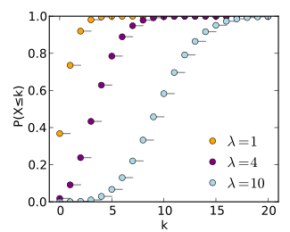
Cumulative Poisson’s Probability
A cumulative Poisson probability refers to the probability that the Poisson random variable is greater than some specified lower limit and less than some specified upper limit.

Slide 9
Example 2: Cumulative
Suppose the average number of lions seen on a 1-day safari is 5. What is the probability that tourists will see fewer than four lions on the next 1-day safari?
Solution: This is a Poisson experiment in which we know the following:
μ = 5; since 5 lions are seen per safari, on average.
x = 0, 1, 2, or 3; since we want to find the likelihood that tourists will see fewer than 4 lions; that is, we want the probability that they will see 0, 1, 2, or 3 lions.
e = 2.71828; since e is a constant equal to approximately 2.71828.

Slide 10
Example 2: Continued
To solve this problem, we need to find the probability that tourists will see 0, 1, 2, or 3 lions. Thus, we need to calculate the sum of four probabilities: P(0; 5) + P(1; 5) + P(2; 5) + P(3; 5). To compute this sum, we use the Poisson formula:
P(x < 3, 5) = P(0; 5) + P(1; 5) + P(2; 5) + P(3; 5)
P(x < 3, 5) = [ (e⁻⁵)(5⁰) / 0! ] + [ (e⁻⁵)(5¹) / 1! ] + [ (e⁻⁵)(5²) / 2! ] + [ (e⁻⁵)(5³) / 3! ]
P(x < 3, 5) = [ (0.006738)(1) / 1 ] + [ (0.006738)(5) / 1 ] + [ (0.006738)(25) / 2 ] + [ (0.006738)(125) / 6 ]
P(x < 3, 5) = [ 0.0067 ] + [ 0.03369 ] + [ 0.084224 ] + [ 0.140375 ]
P(x < 3, 5) = 0.2650

Slide 12
Additional Reading

Slide 13


